Slide 1
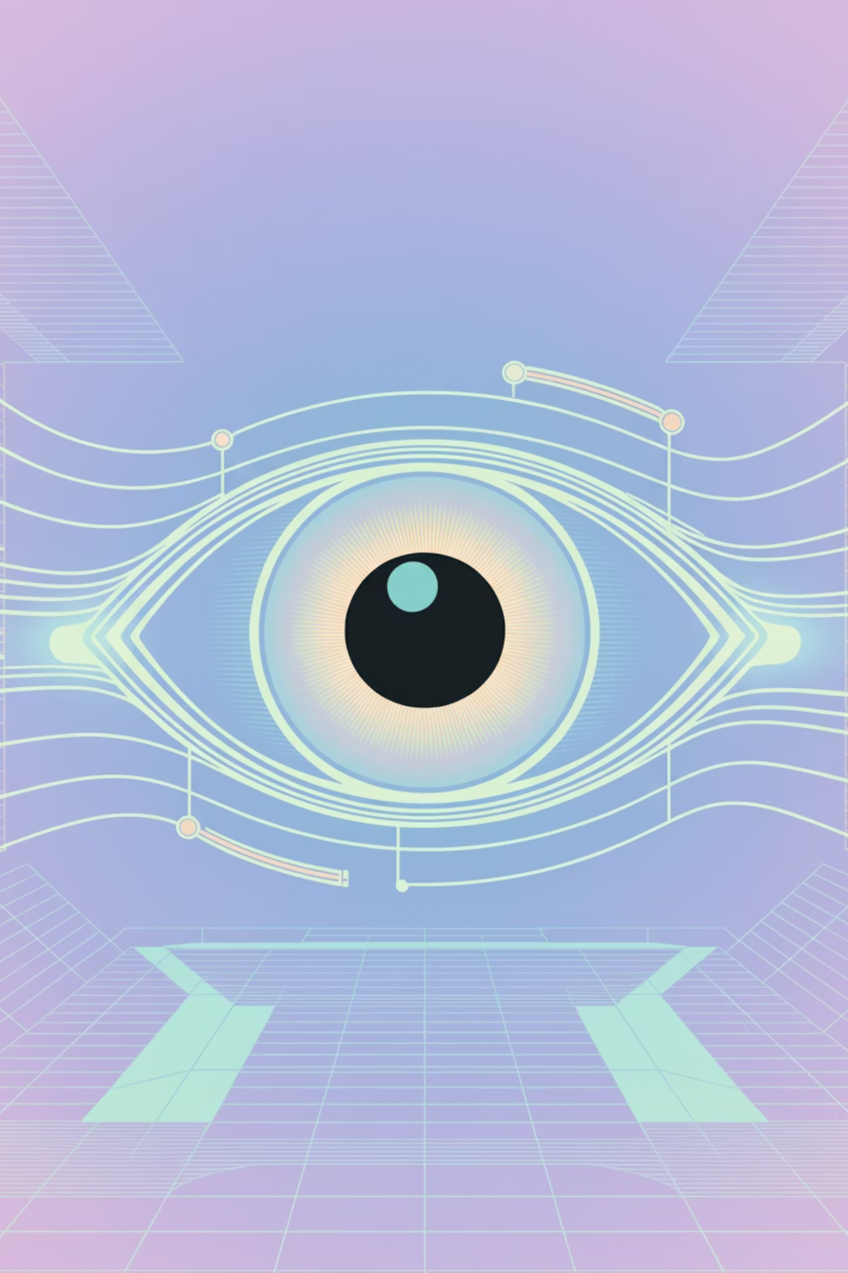
Synapse: Unleash your superpower, unlocking vibrant vision for ultimate freedom and exploration.

Slide 2


Digital Sight in Real-Time
"With a single, intuitive tap, Synapse ignites your perception, transforming every step into an adventure of unparalleled independence. Navigate the world with boundless confidence, knowing that if a moment calls for an extra spark of human brilliance, expert guidance is there, instantly by your side."

Slide 3
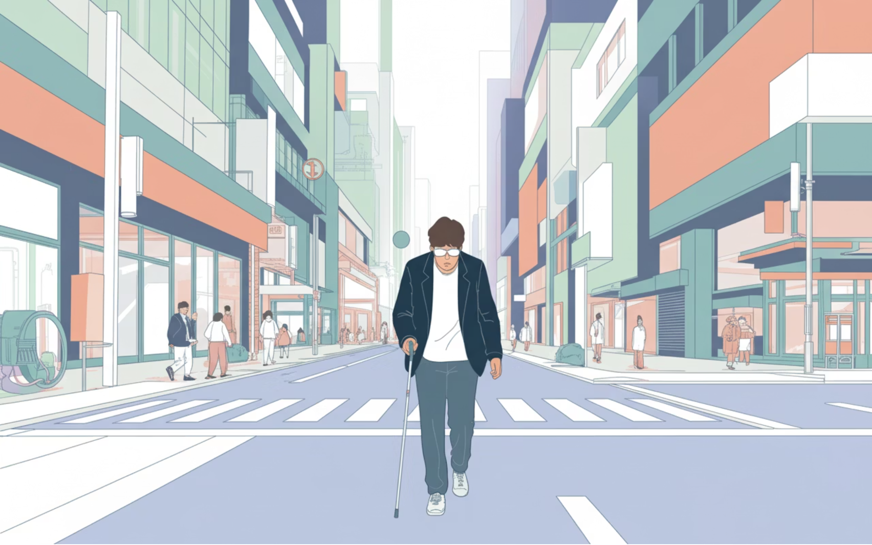

Synapse: Your Passport to Limitless Living
Imagine a world where every step is an adventure, not a challenge. For millions, traditional paths can feel restrictive, but with Synapse, a universe of vibrant experiences awaits, transforming uncertainty into exhilarating freedom.
Picture yourself confidently gliding through a bustling city, effortlessly deciphering every sign, and recognizing every detail in a vibrant marketplace. Synapse turns these moments into triumphs, unlocking unparalleled independence and boundless opportunities.
Before Synapse: The Era of Hesitation
Navigating an unadapted world often meant a constant battle with hidden obstacles and missed moments. But that chapter of uncertainty is now closing, opening a new one of confident exploration.

Slide 4
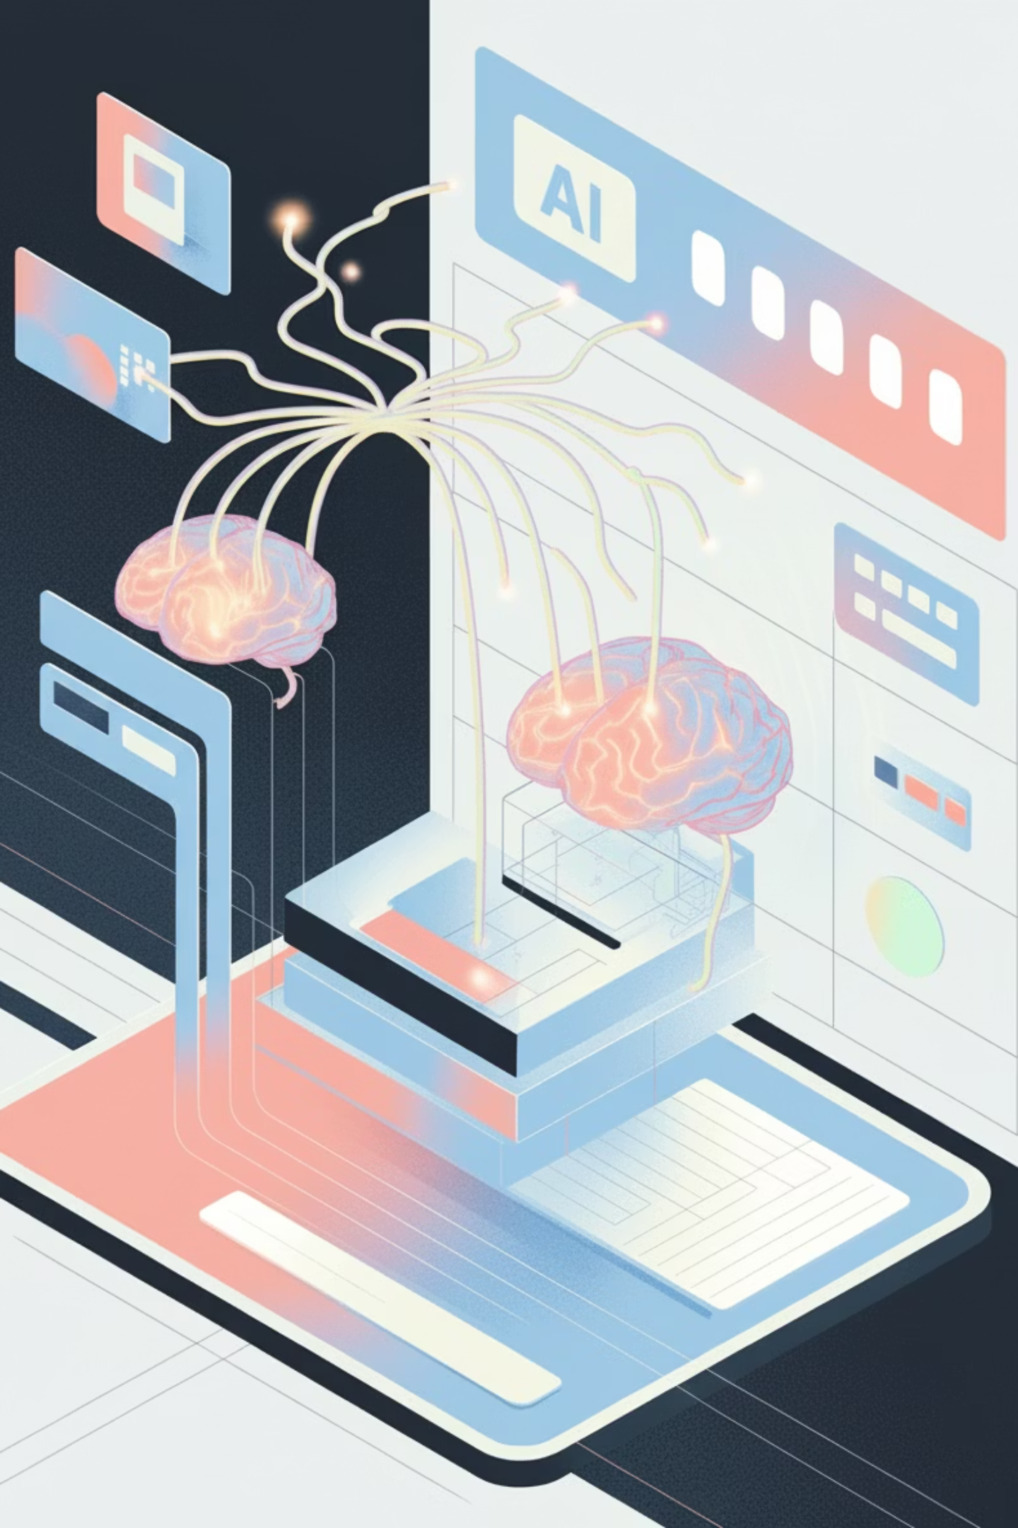

Synapse: Your Superpower to Explore!
Synapse isn't just a tool; it's your personal guide to a world of boundless possibilities. It grants you the ultimate freedom to move, transforming every step into a confident stride. Powered by Gemini 3 Flash, Synapse sees beyond mere objects, with profound clarity, giving you the intuitive understanding to navigate any path.
Uncover Your World
Your Intuitive Guide
Empowering Partnership
Synapse reveals the intricate connections painting a complete picture of your environment.
With predictive brilliance, Synapse anticipates your journey, offering timely insights
Our AI works hand-in-hand with human connection, creating a supportive network

Slide 5
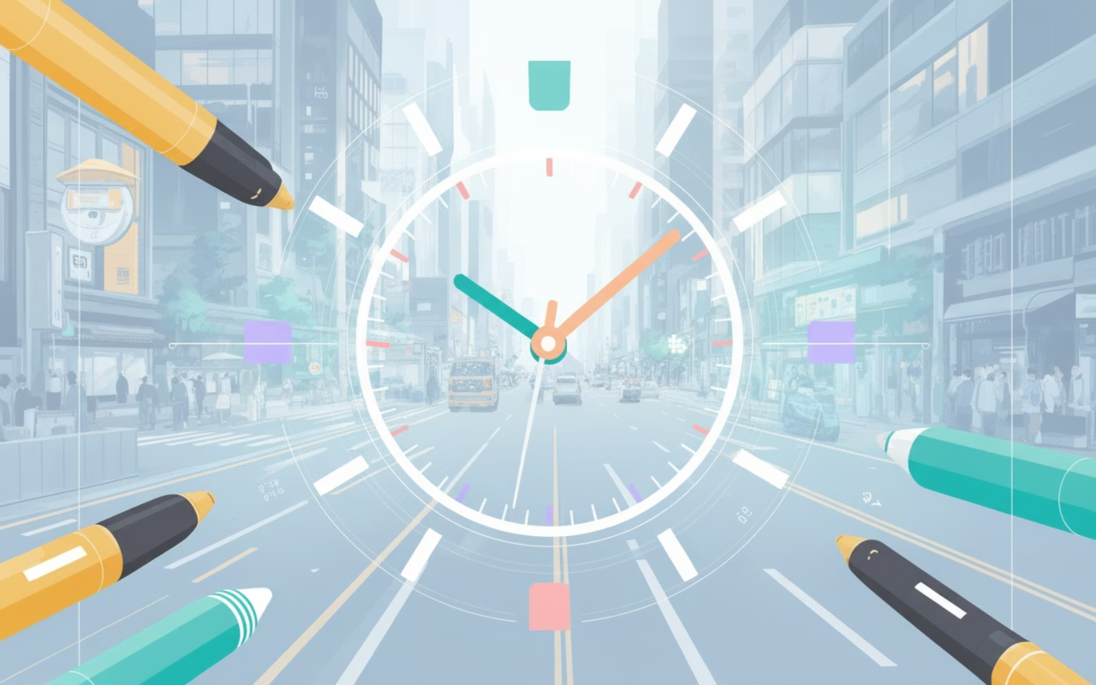
Unlock Your World: The Glance – Your Superpower for Spatial Mastery
Your Intuitive Compass
Synapse doesn't just see; it illuminates your surroundings. With crystal-clear verbal cues, it pinpoints objects and their positions with breathtaking precision, empowering you to move through life with unparalleled grace and independence.
Instant clarity: Locate objects in a blink, painting a vivid picture of your surroundings.
Effortless navigation: Guide spaces with dynamic warnings that intuitively guide you around obstacles, making every path open.
Harmonious interaction: Experience a seamless flow, as Synapse adapts its insights to your every move.

Slide 6
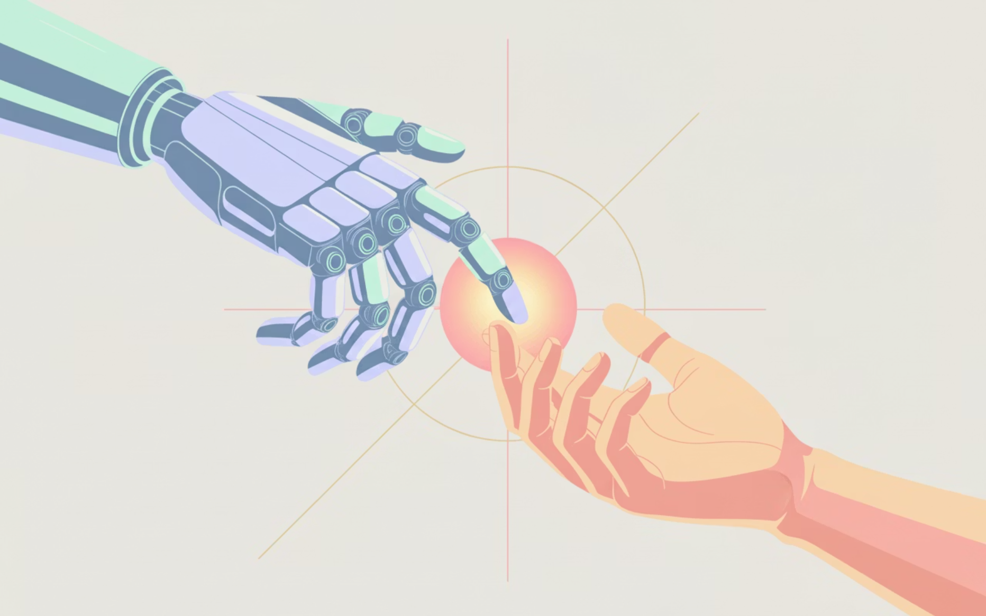
Core Superpower 2: The Freedom Link – Unleashing Seamless Human-AI Synergy
Your Intuitive Co-Pilot: Unwavering Support
Imagine a world where challenges melt away, powered by an intelligent partner who knows exactly when to amplify your experience with human brilliance. Synapse ensures your journey is always smooth. It's not just assistance; it's a vibrant extension of your own capabilities
AI intelligently senses when a human touch adds the most value.
Empowering connection to a dedicated human guide.

Slide 7
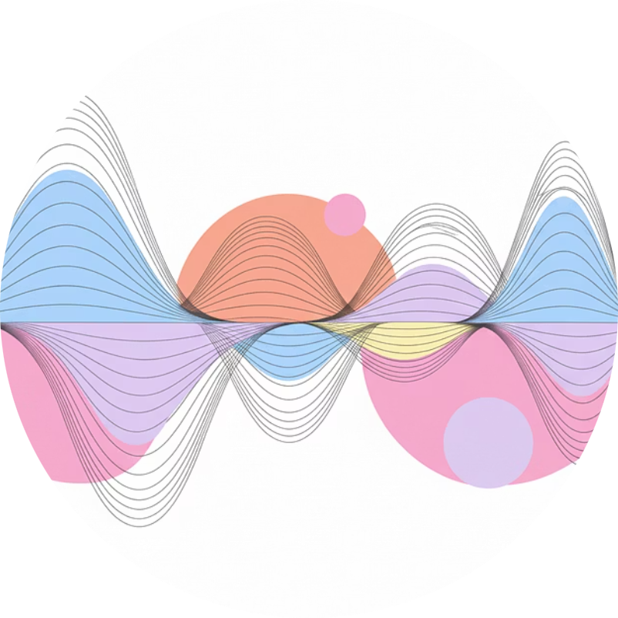


Synapse: Your Social Superpower for Unstoppable Independence
Synapse isn't just about moving through spaces; it’s about commanding them. This groundbreaking AI grants you the ultimate social superpower, sensing the unspoken language of every room – from the vibrant energy of conversations to the electrifying buzz of a crowd – giving you the unwavering confidence to truly connect and thrive.
Heartbeat of Conversation
Pulse of the Gathering
Unlocking Social Dynamics
Instantly tune into the emotional cadence of every discussion, making your connections richer and more authentic.
Feel the collective energy and flow of any crowd, allowing you to effortlessly join or navigate social scenes with newfound ease.
Unfold the secrets of social interplay, empowering you to respond perfectly and feel completely at home in any situation.

Slide 8
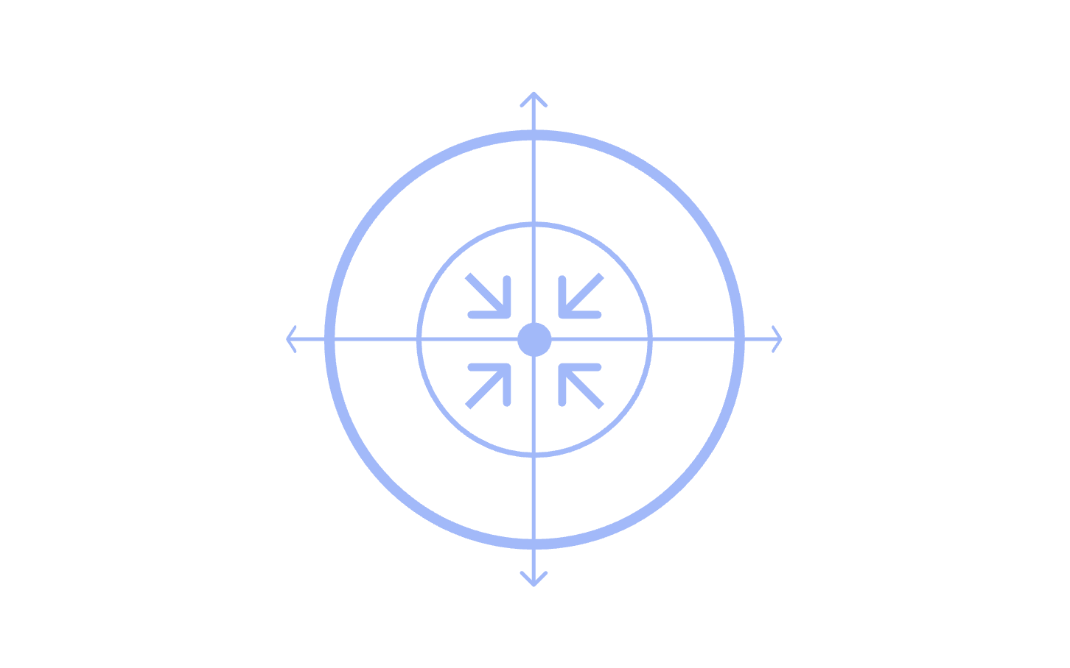
Unlock Your Superpower: Unrestricted Freedom with Synapse
Instant Perception
Unbreakable Trust
Heightened Senses
Intuitive Connection
Instant Perception: Our advanced AI effortlessly processes the vibrant tapestry of visual and auditory information around you, opening up new dimensions of awareness.
Intuitive Connection: Experience true freedom with an interface that melts away. Through subtle haptic feedback and spatial audio, Synapse communicates vital insights discreetly, becoming a natural extension of your senses, guiding you seamlessly through any environment.
Unbreakable Trust: Journey fearlessly, knowing your privacy is paramount. Synapse champions your autonomy with crystal-clear data security, ensuring your personal journey remains uniquely yours, protected by end-to-end encryption and anonymised processing.

Slide 9
Unlocking a World of Freedom: Synapse's Vision & Impact
The Untapped Power of Independent Navigation
Fueling Freedom: Our Sustainable Model
Our business model is designed to scale with your ambition, creating a recurring ripple of empowerment:
The global pursuit of independent living is surging, fueled by a vibrant, diverse population yearning for freedom of movement and self-determination. This dynamic market represents an estimated $13 trillion in spending power – a powerful, yet historically underserved, force for innovation.
Personalized Journeys: Offering flexible tiers of AI guidance and dedicated human support, from essential orientation to advanced social engagement.
Transformative Spaces: Partnering with public venues, transportation networks, and educational hubs to integrate seamless, intuitive navigation for all.
Strategic Alliances: Collaborating with pioneers in health, community care, and government to weave a wider web of access and opportunity.
Synapse stands ready to ignite this potential, delivering an unparalleled solution that empowers individuals to navigate their world with boundless confidence, joy, and safety.

Slide 10
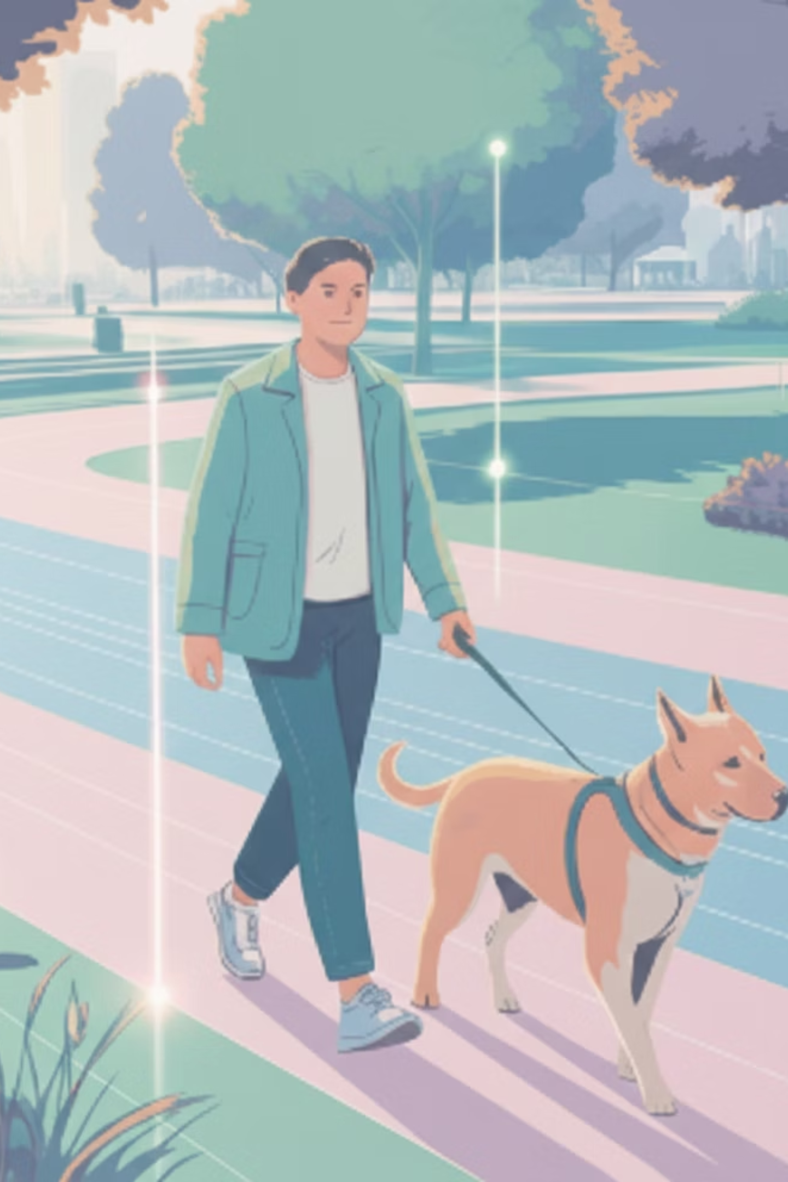
Unleash Your Superpower: The Synapse Vision
Imagine a world where every step is a confident stride, every interaction a vibrant connection, and every journey an adventure. Synapse isn't just technology; it's the key to unlocking boundless autonomy. We empower individuals to experience the world with unparalleled freedom, engaging with people, and embracing life's full spectrum on their own magnificent terms.

